Slide 1
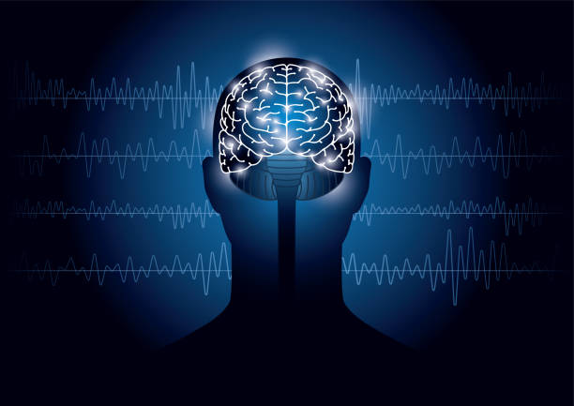

Order Preserving Matching for ADHD analysis using EEG waves
Lecturers Guide: Dr. Anat Dahan Dr. Samah Idrees Ghazawi Students Submit: Tamir Nahari Yaakov Shitrit
Notes:
לתת הסבר על על המטרה של מציאת תבניות

Slide 2


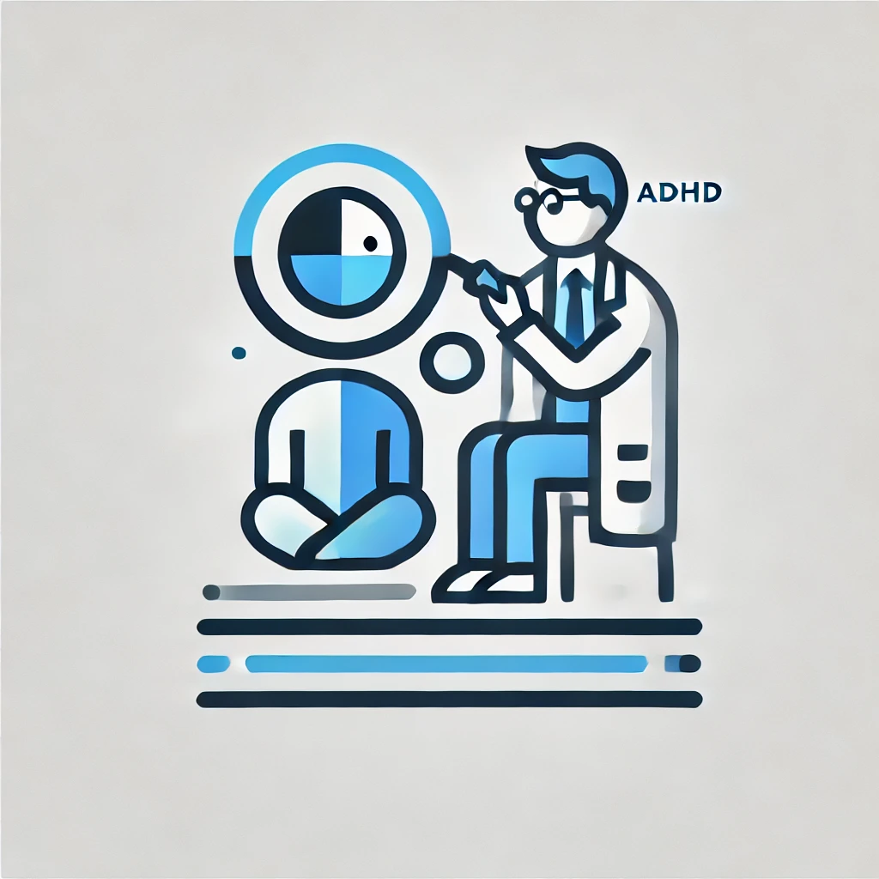

ADHD
There is an increase in the number of children diagnosed with ADHD.
The existing diagnosis is based on the actions of the person being diagnosed at that moment.
This means that the existing diagnosis is not completely accurate And we would like to find more accurate approach to diagnosing ADHD..

Slide 3
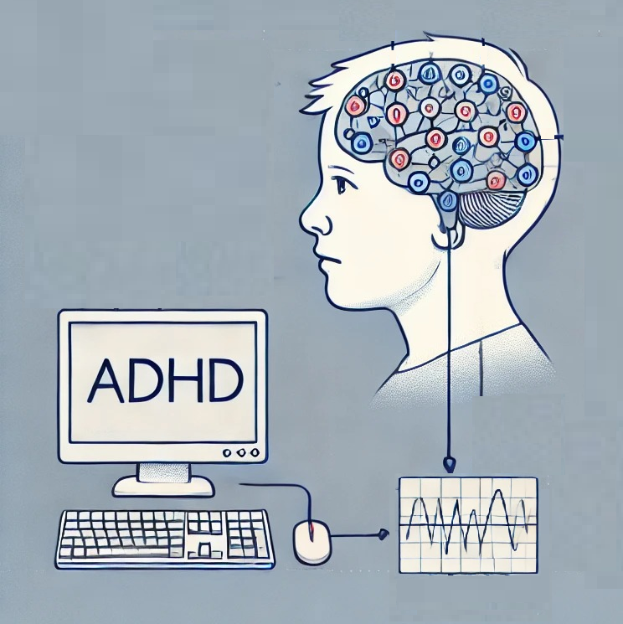
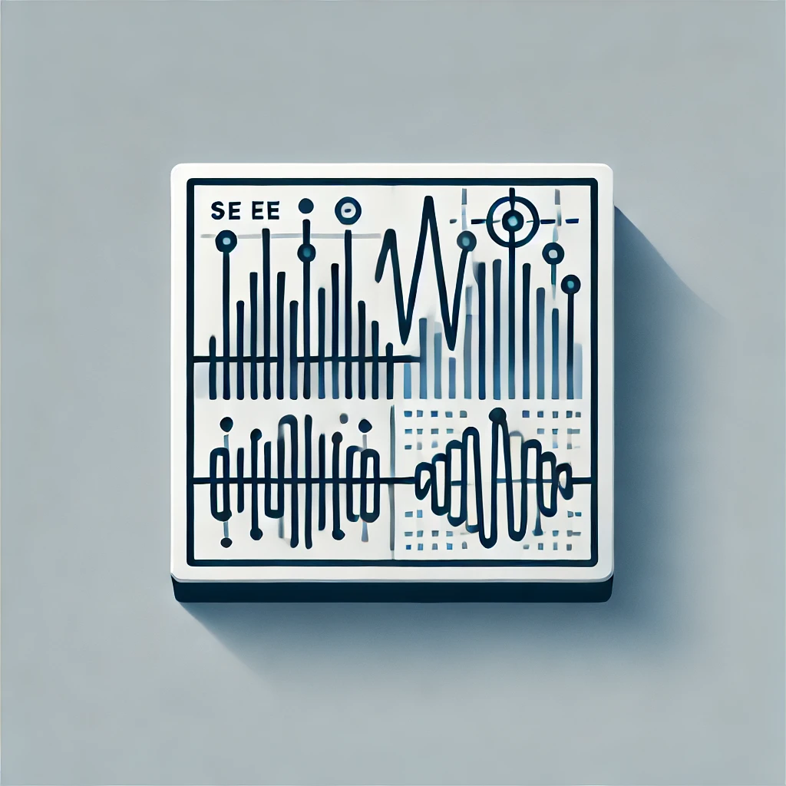

What Are We Trying to Find?
We will receive information from brain waves using EEG electrodes and analyze it using the algorithm of the proposed solution
We would like to find patterns that appear
mainly in the ADHD group
in the NON-ADHD group but not found in the ADHD group at all
Notes:
If we find patterns of these 2 types, we can say that our algorithm is able to diagnose ADHD

Slide 4
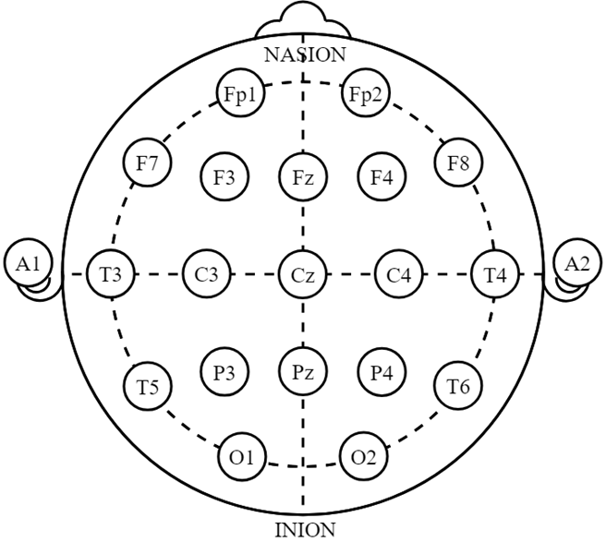

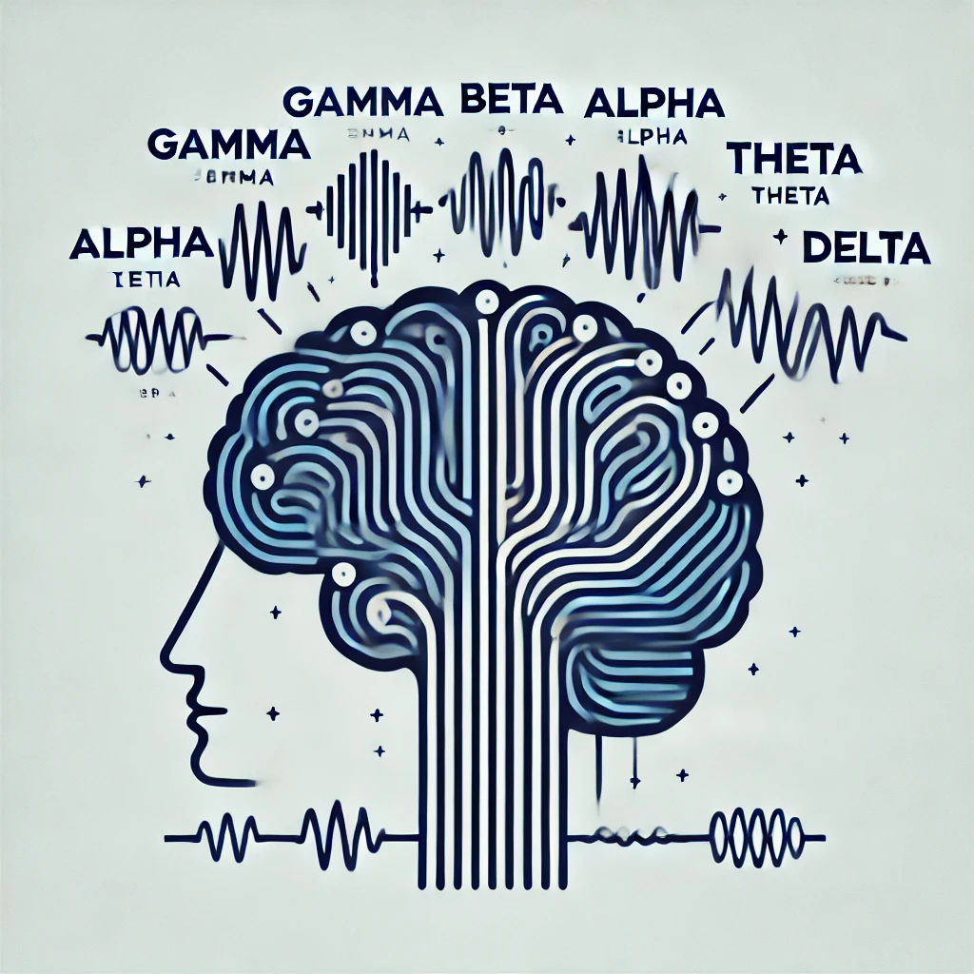
What are the EEG waves?
EEG waves are electrical oscillations measured in the brain, which reflect the neural activity of the brain at a given time.
These oscillations are divided into different types such as gamma, beta, alpha, theta and delta, depending on their frequency and the brain states they represent.

Slide 5
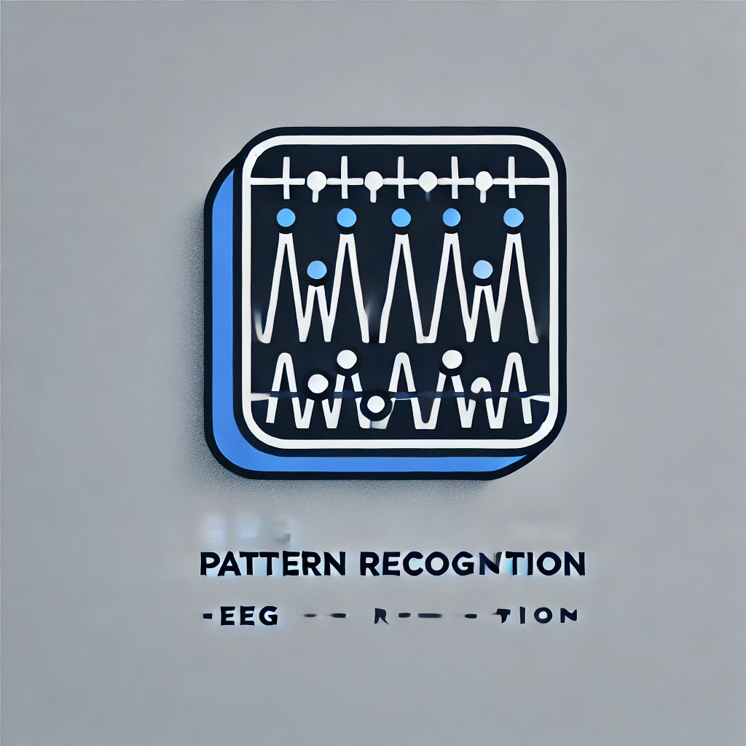
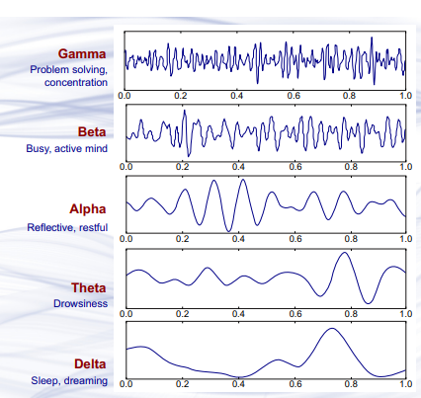
Frequencies in EEG waves
EEG captures electrical brain waves, classified into distinct frequency bands that reflect various brain states and activities.
Frequency Bands:Delta (0.5–4 Hz): Deep sleep.
Theta (4–8 Hz): Relaxation and meditation.
Alpha (8–12 Hz): Calm but alert states.
Beta (12–30 Hz): Concentration and stress.
Gamma (>30 Hz): Complex cognitive functions.
Challenges: EEG is sensitive to external noise.

Slide 6
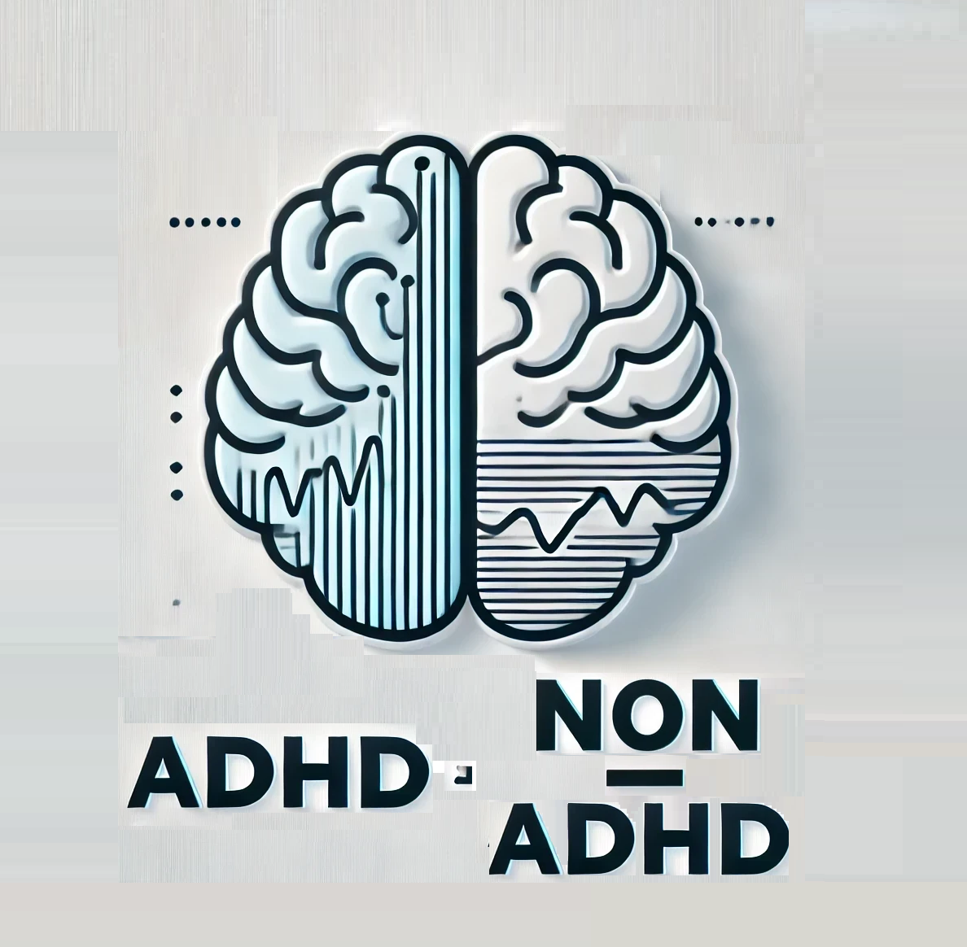
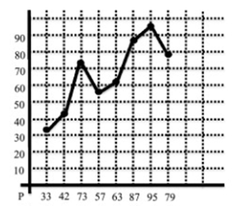
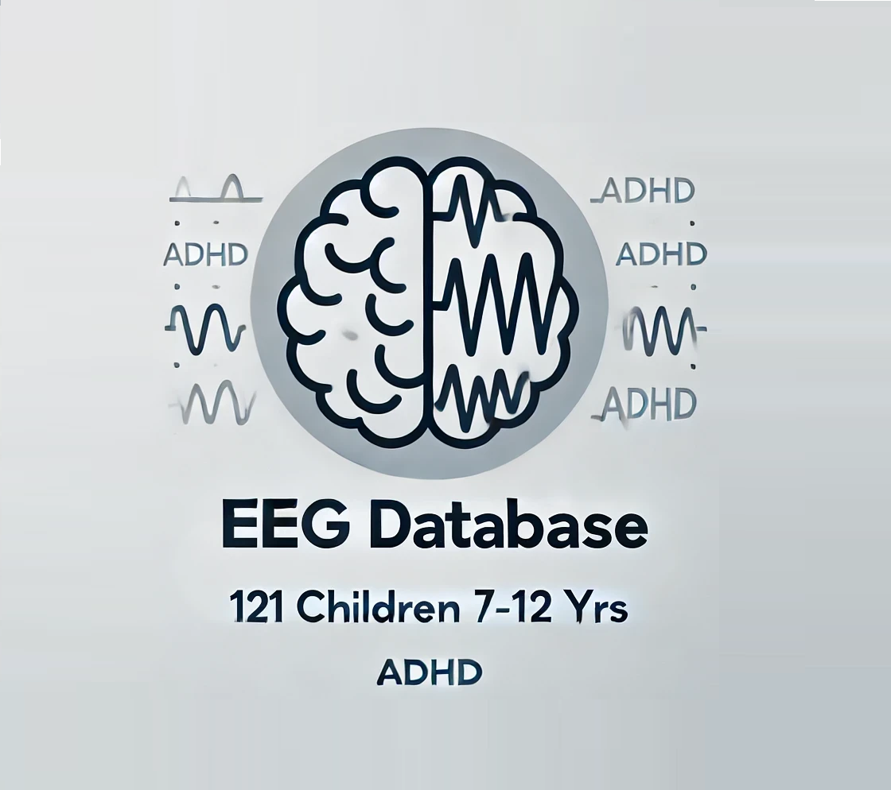
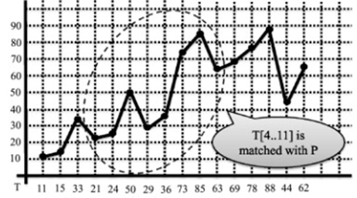
OPM - Order Preserving Matching
(OPM) is a specialized form of pattern matching that focuses on the relative order of elements within a sequence rather than their exact values.
Matching Based on Relative Order:
Instead of comparing direct values the algorithm compares their relative ranking.
For example: If the sequence is [3, 8, 5], it can be represented as the relative order [1, 3, 2], where:
1 represents the smallest value (3)
3 represents the largest value (8)
2 represents the middle value (5).
,

Slide 7
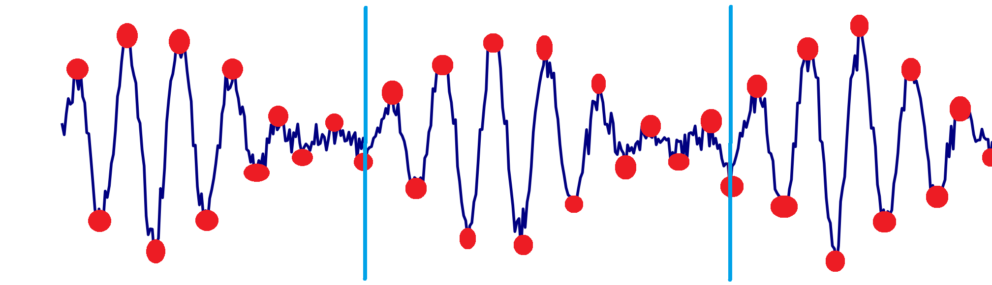
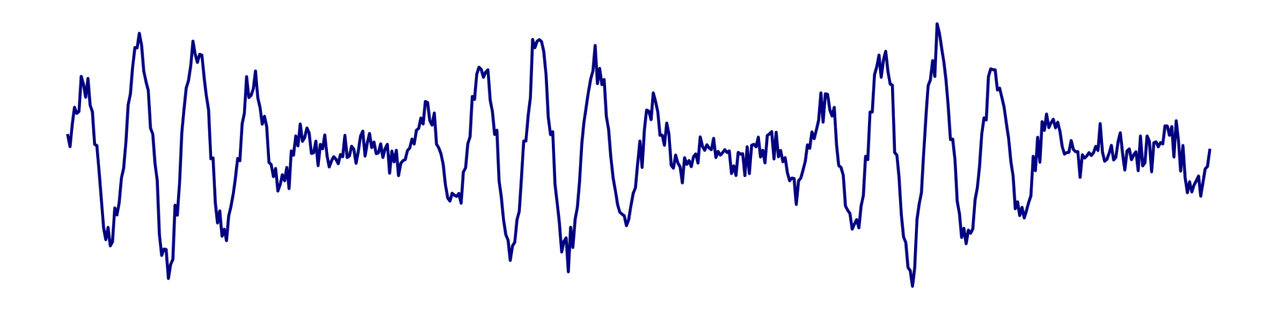
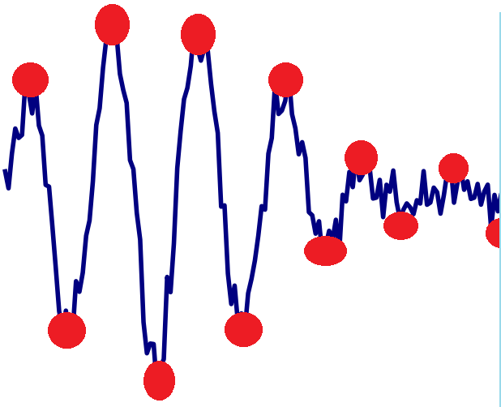
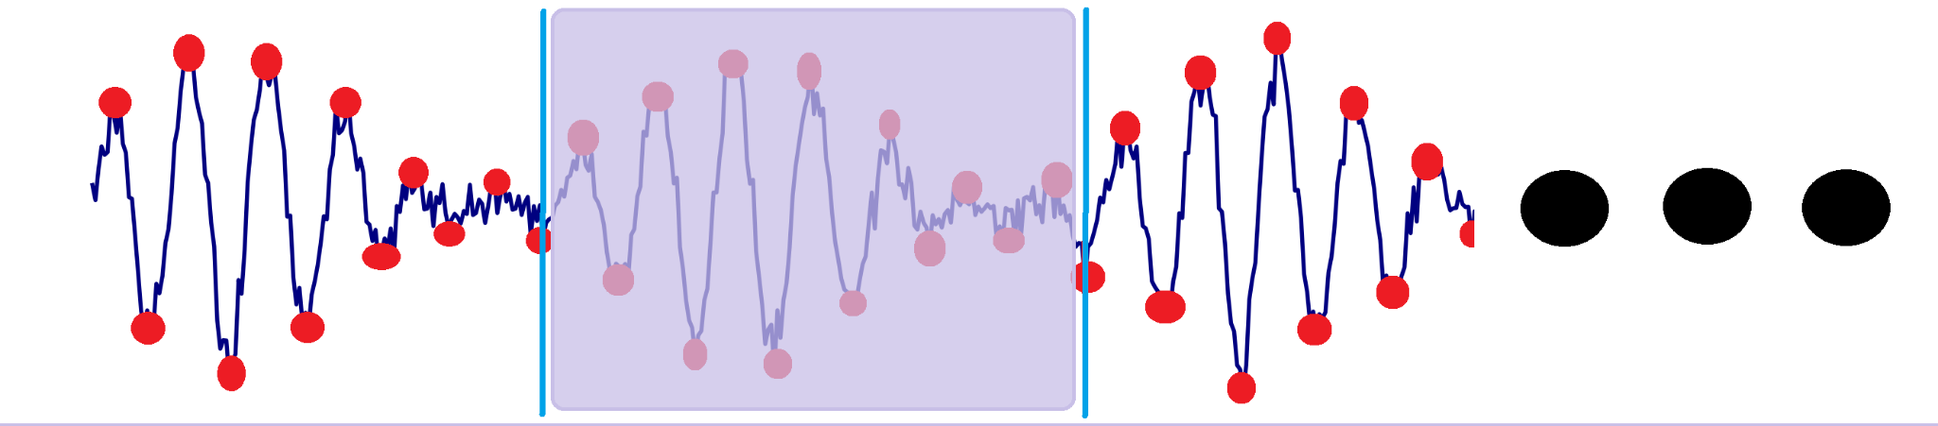
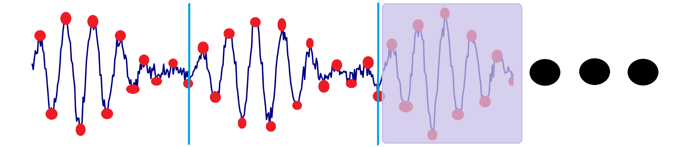
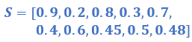
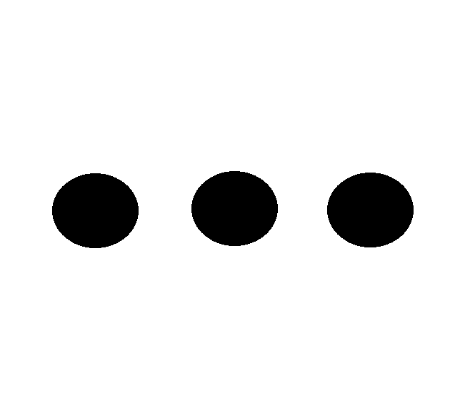
OPM for EEG wave
Division into segments and choosing a pattern
EEG Wave
For each pattern P in the graph
Pattern
Searching for a P pattern
S series of points

Slide 8
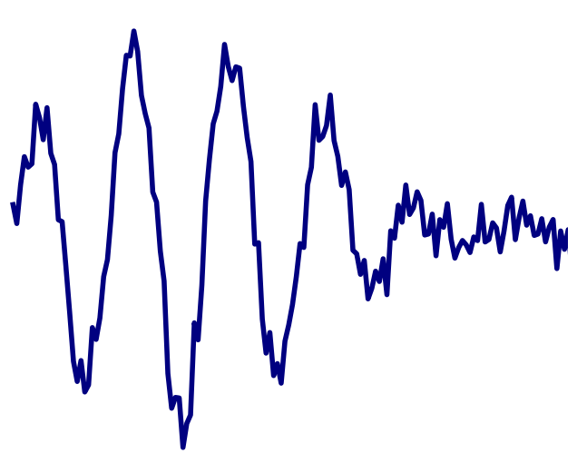
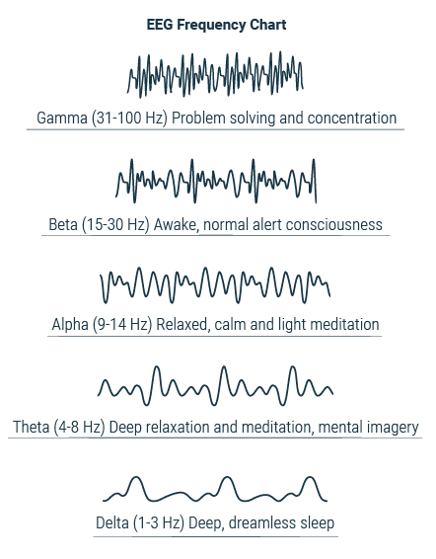
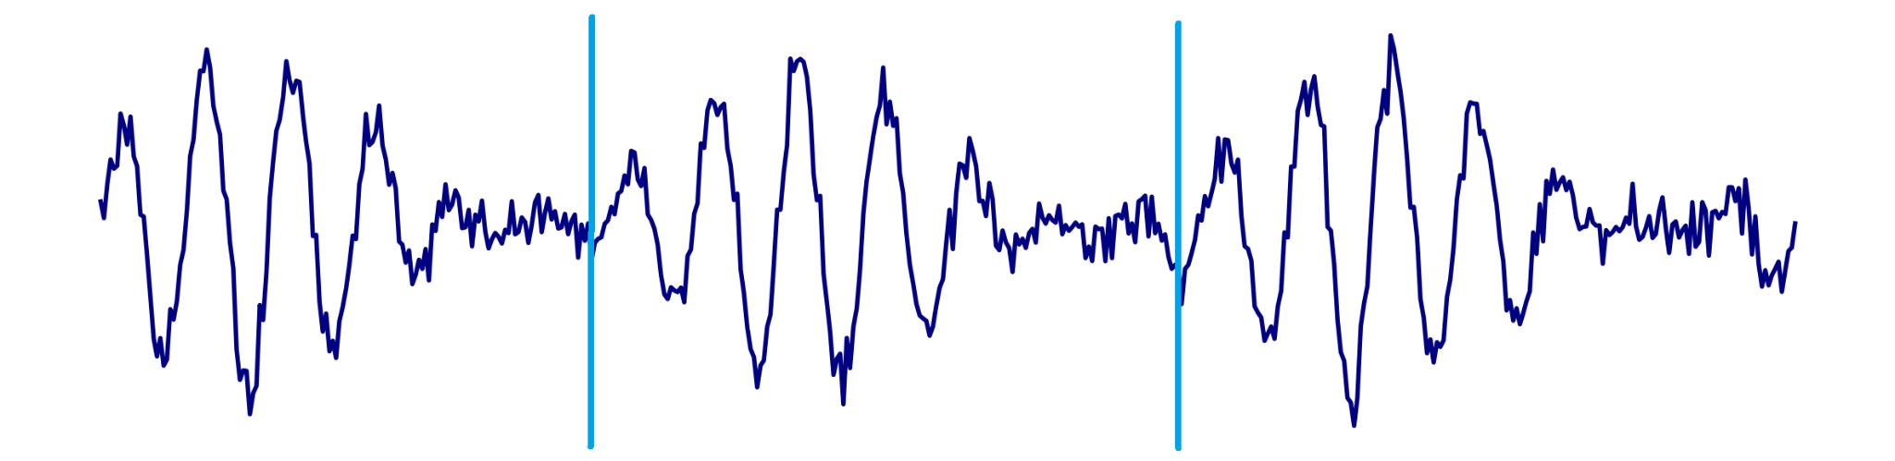
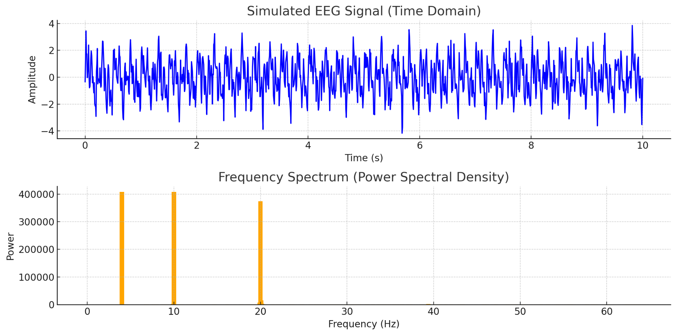
Using FFT to find frequency patterns
Spectral analysis uses an algorithm such as FFT (Fast Fourier Transform) to convert the signal from the time domain to the frequency domain.
Division into time segments
The process identifies the frequencies that make up the signal and calculates the power of each frequency, which shows how strong each frequency is.
Initially, the EEG signal is represented as changes in voltage over time.

Slide 9
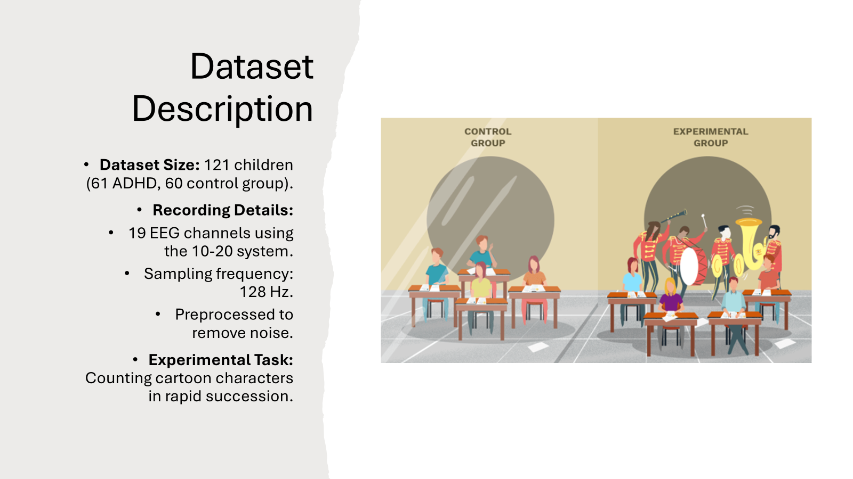
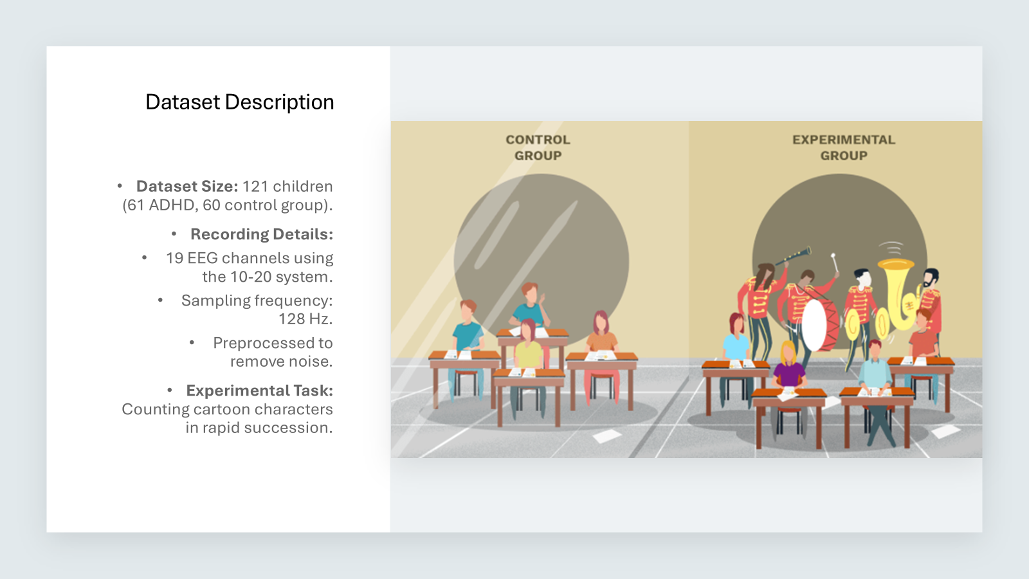
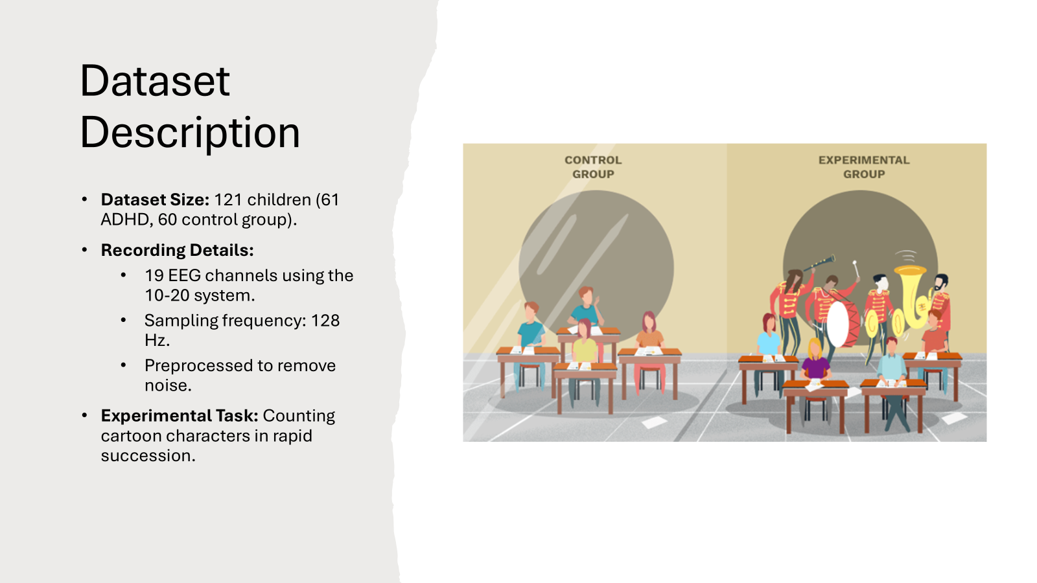
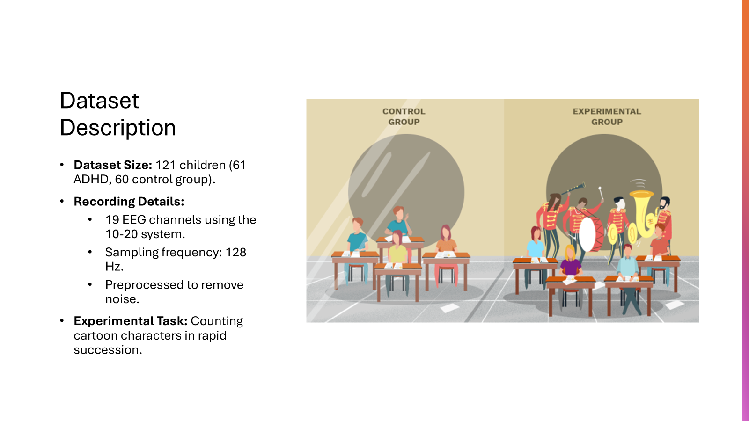
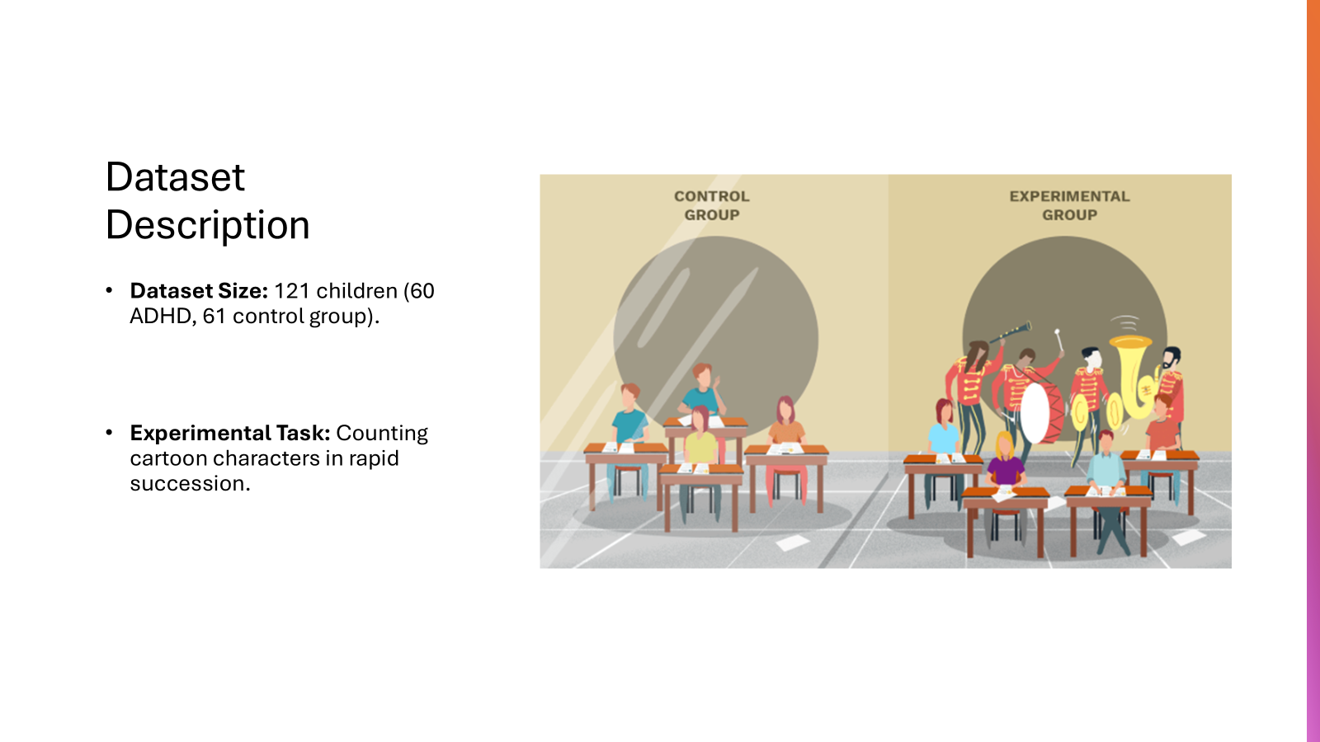
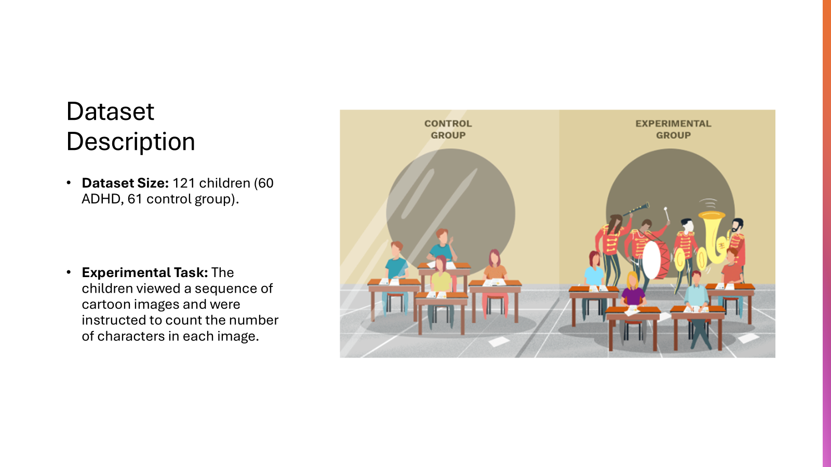

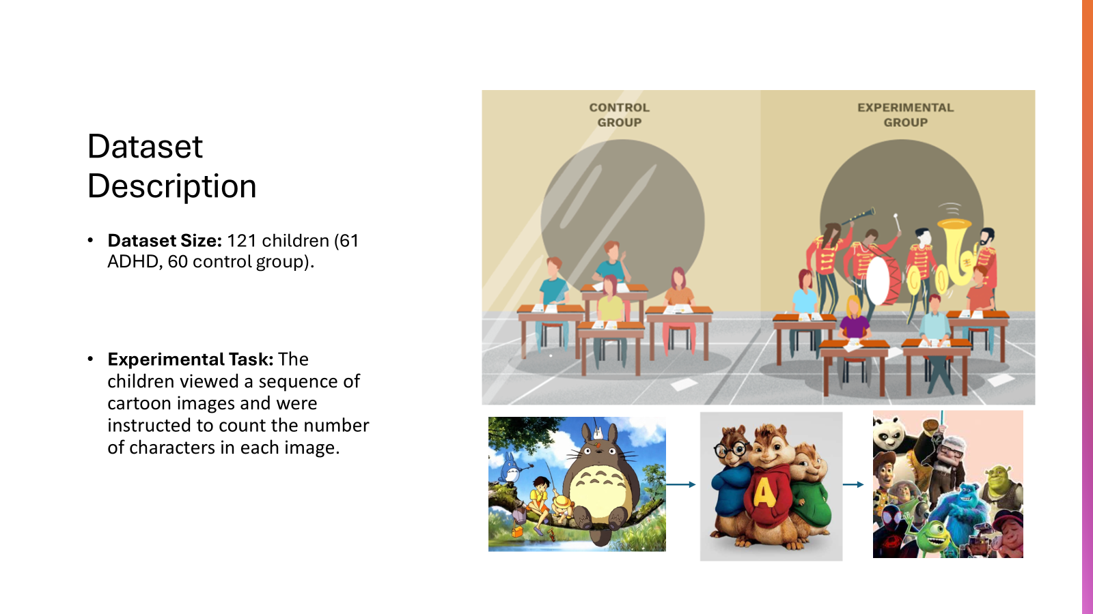

Dataset Description
Dataset Size: 121 children (61 ADHD, 60 control group).
Recording Details:
19 EEG channels using the 10-20 system.
Sampling frequency: 128 Hz.
Preprocessed to remove noise.
Experimental Task: Counting cartoon characters in rapid succession.

Slide 10
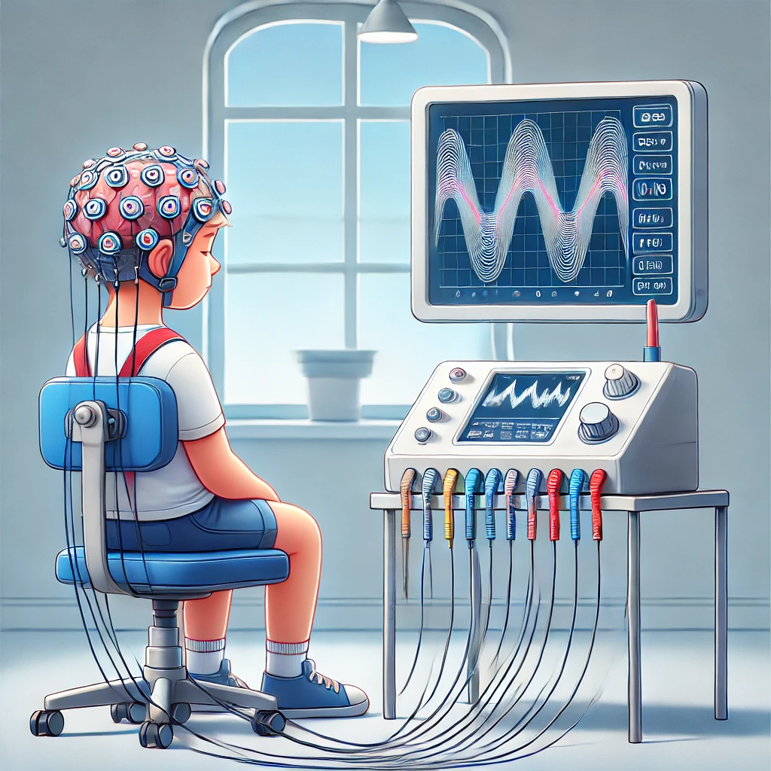
The dataset
The database includes EEG scans collected from 121 children aged 7-12, of whom 60 were diagnosed with ADHD and 61 without the disorder.
•Recording Details:
•19 EEG channels using the 10-20 system.
•Sampling frequency: 128 Hz.

Slide 11
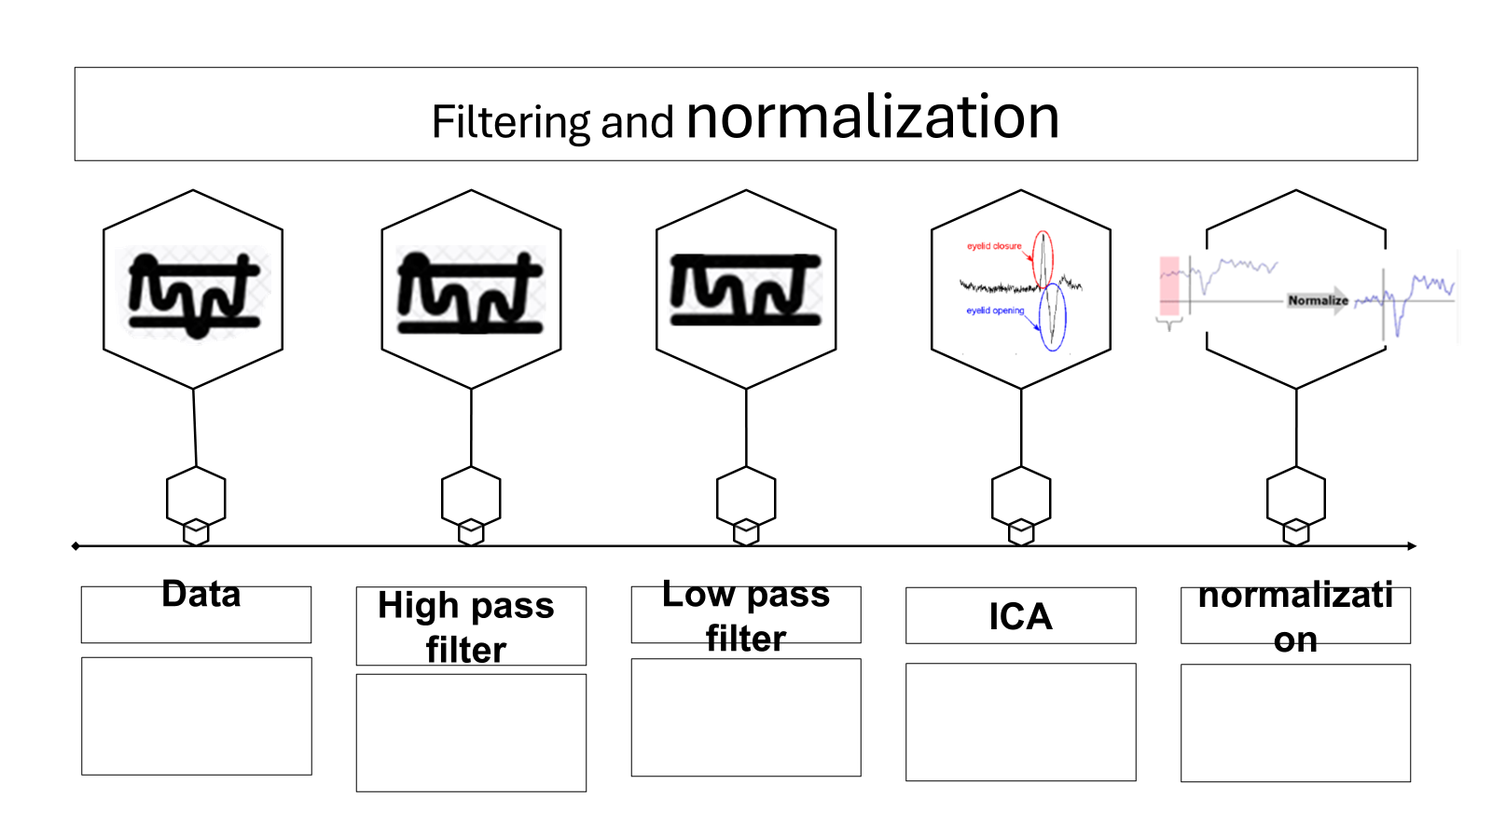
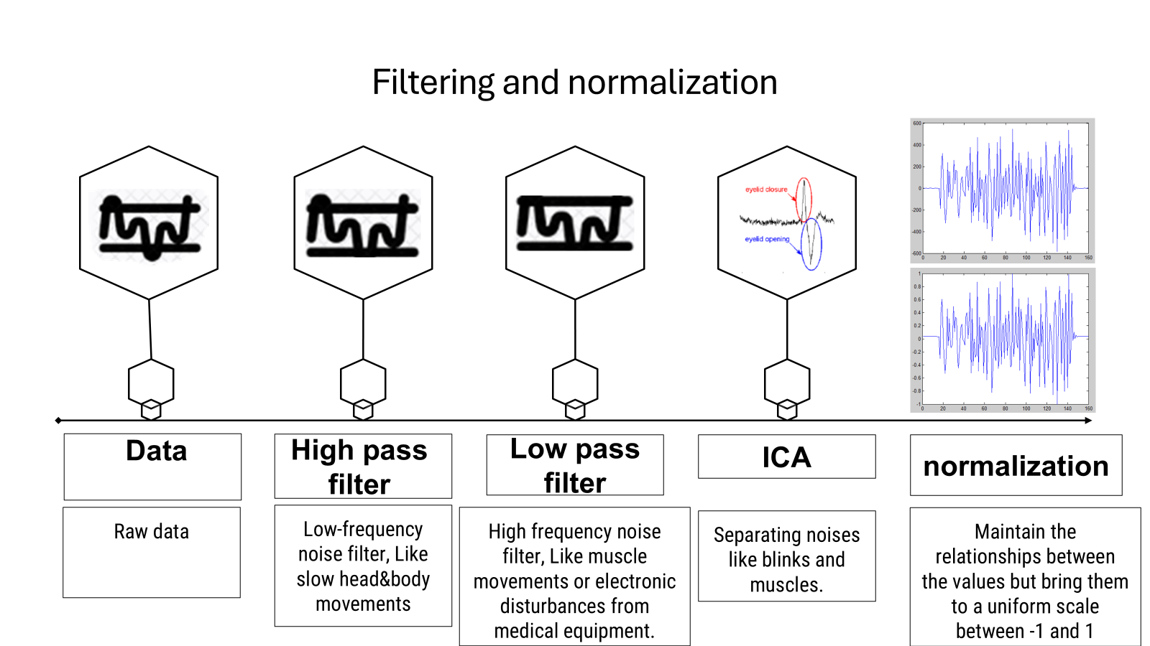
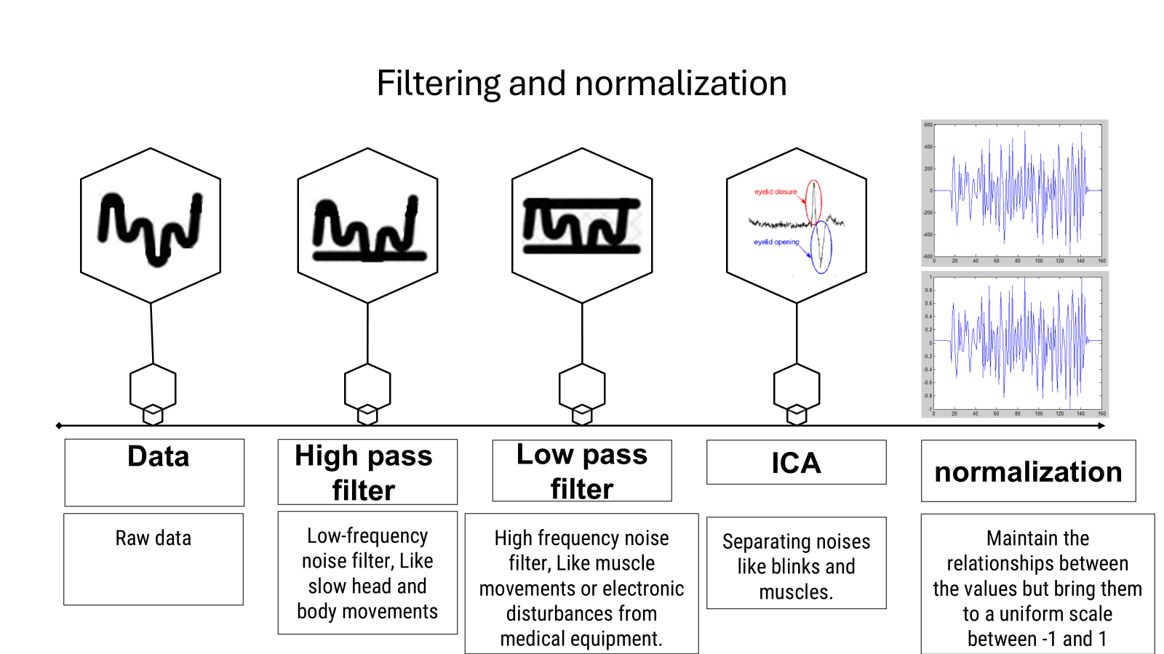
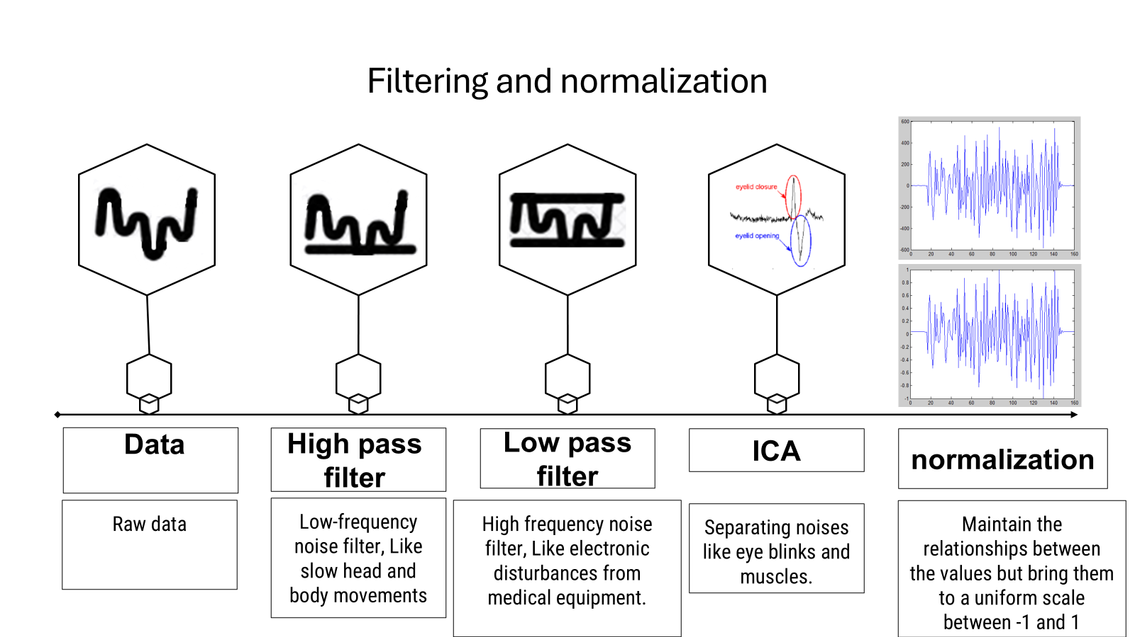

Noise removal
Filtering (High-pass, Low-pass)
- ICA for artifacts
- 19 channels each
Normalization - Standardizing signals

Slide 12
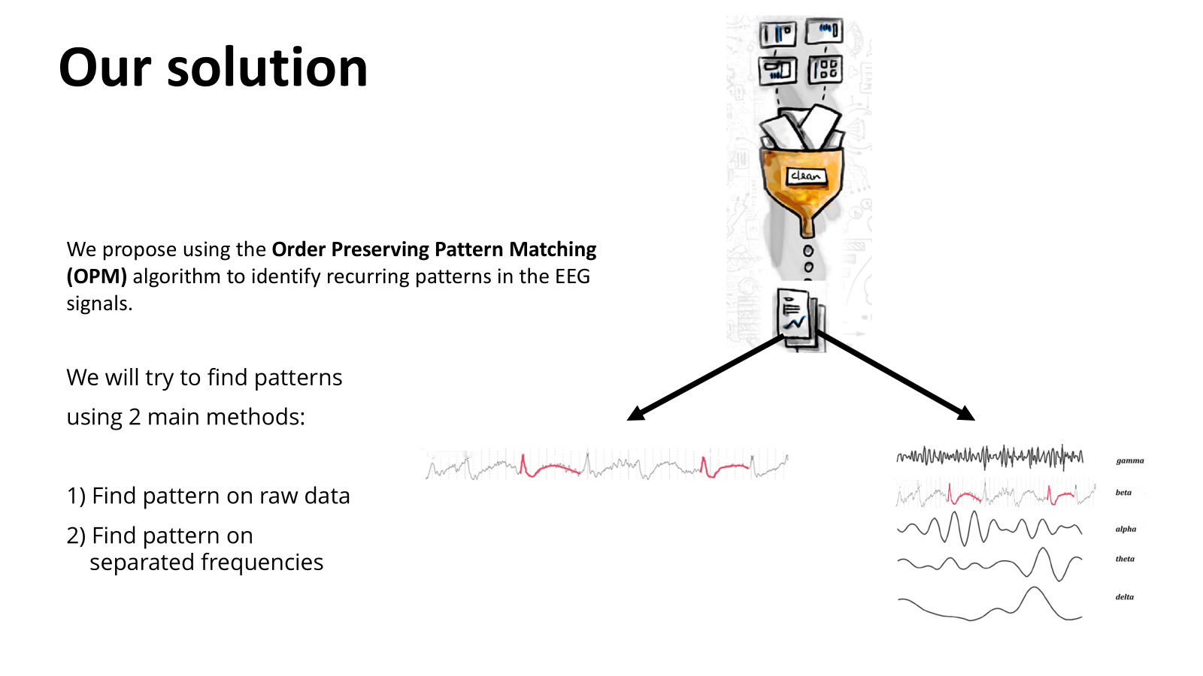
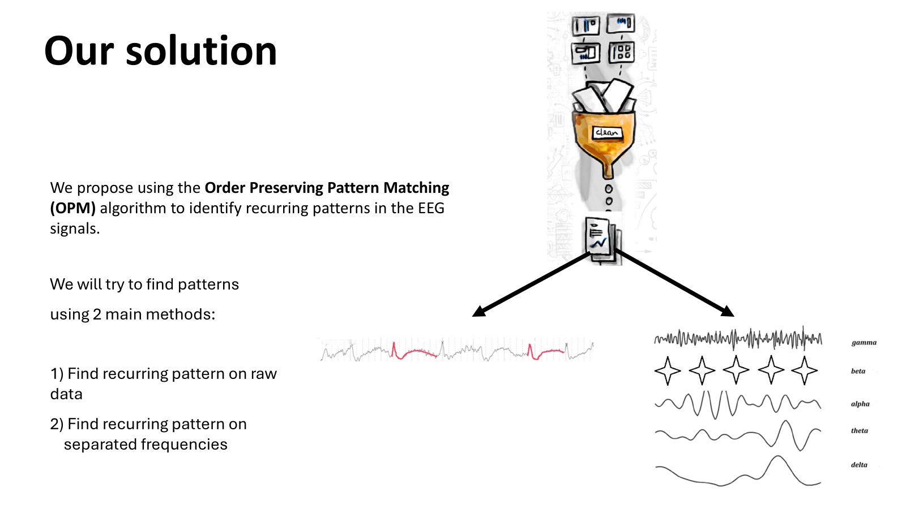
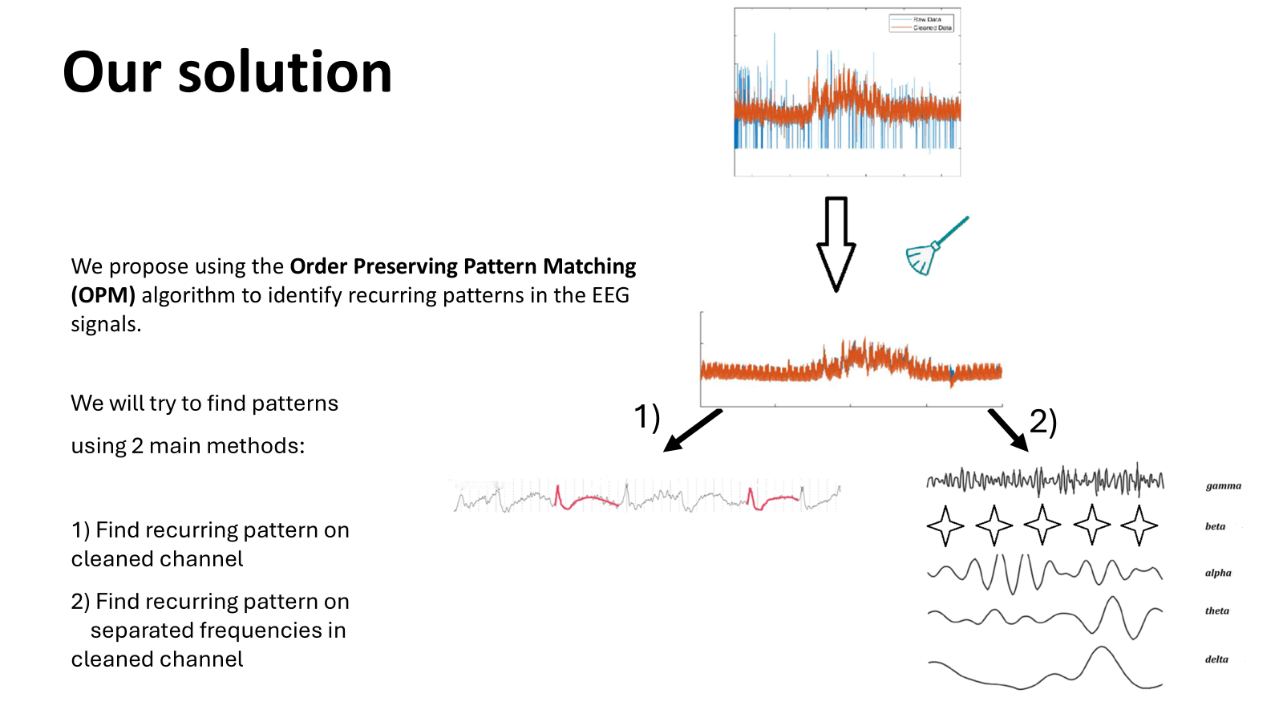
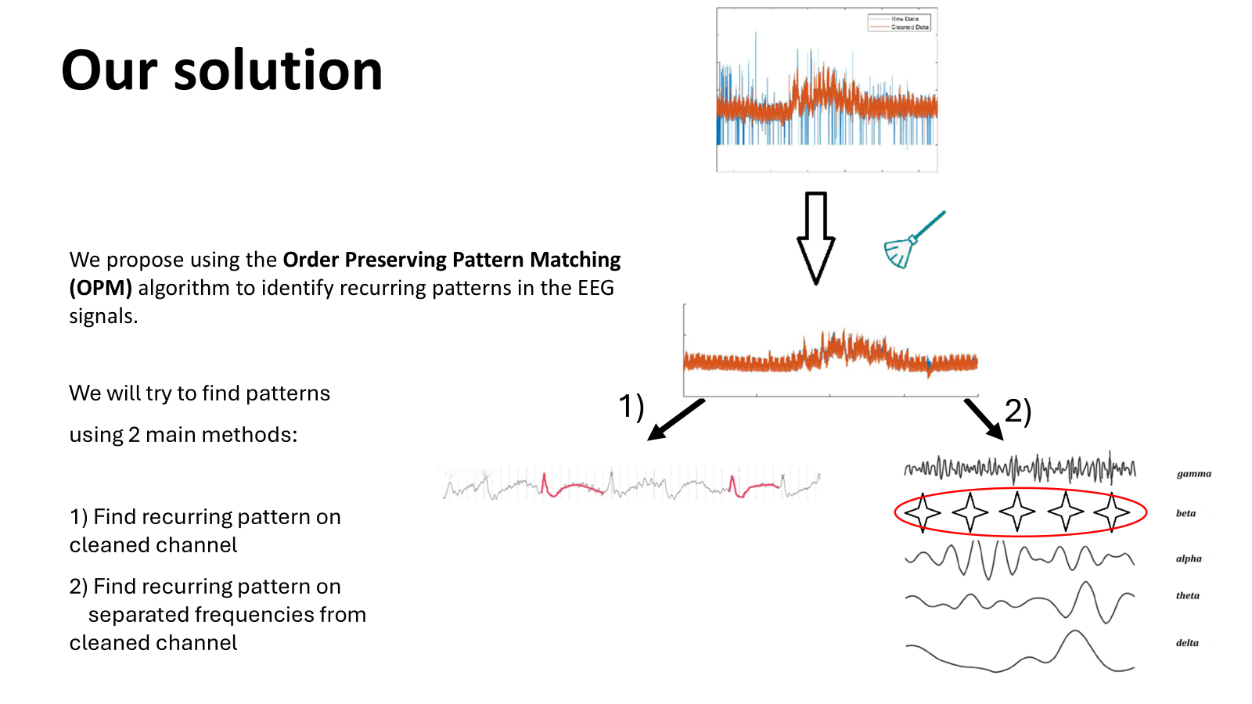
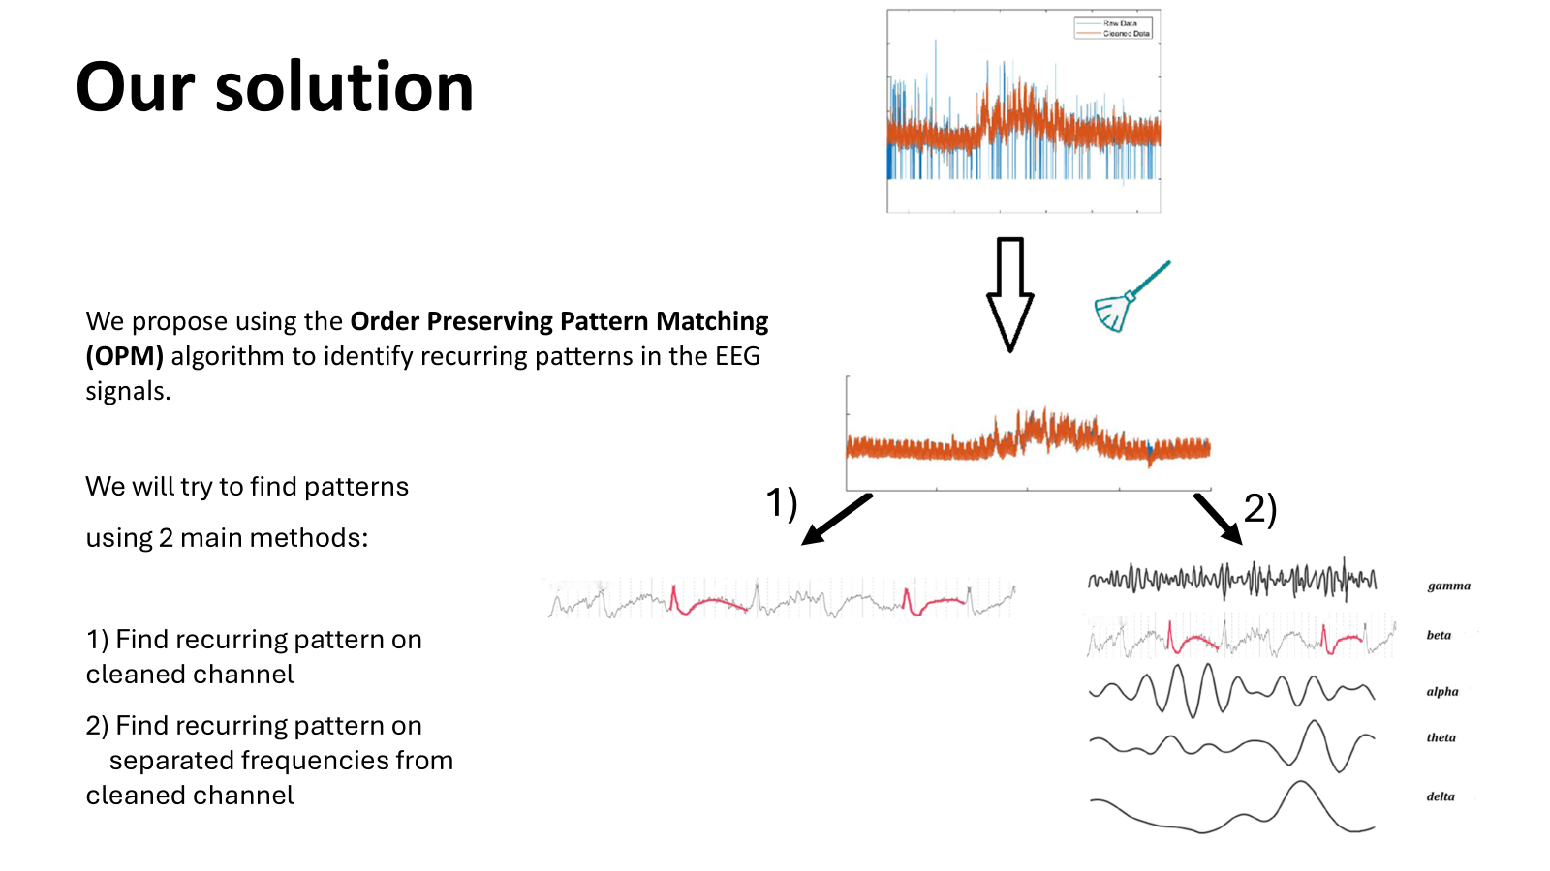
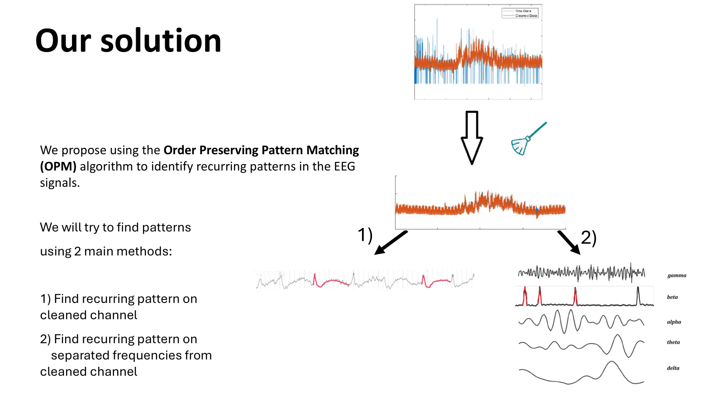
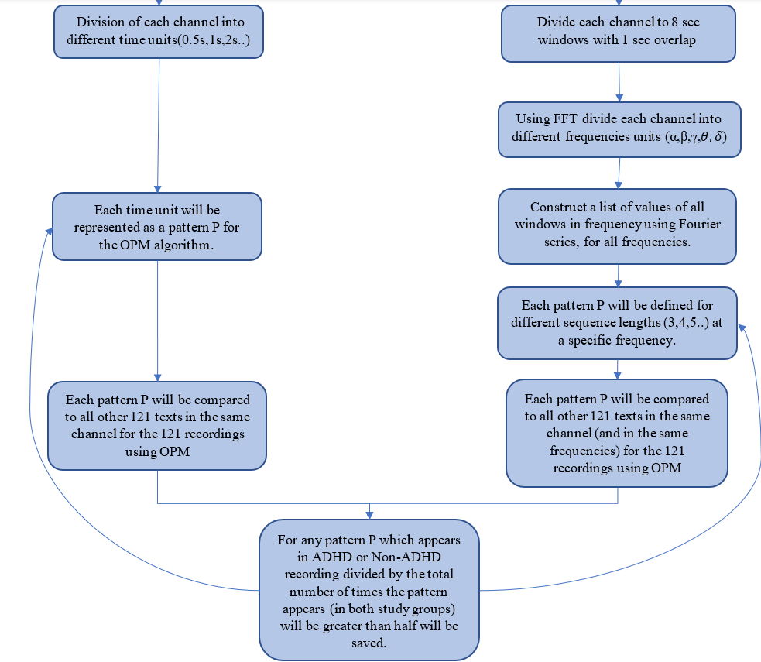
Our solution
We propose using the Order Preserving Pattern Matching (OPM) algorithm to identify recurring patterns in the EEG signals.
We will try to find patterns using 2 main methods:
1) Dividing each channel into time units, where each time unit is a pattern.
2) Dividing by frequencies, each frequency of a certain length will be a pattern

Slide 13
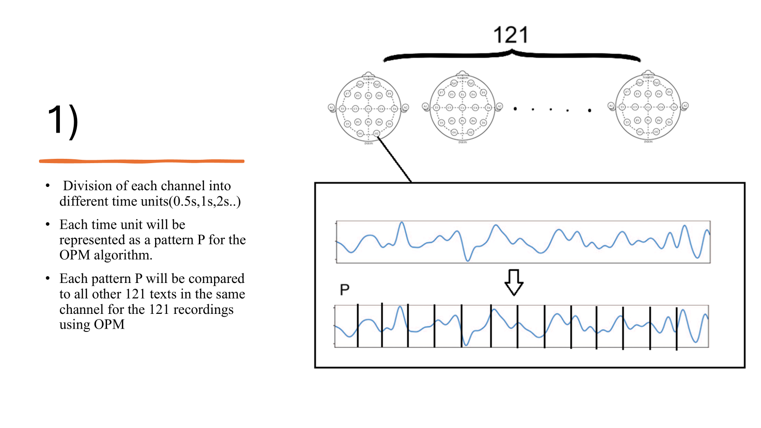
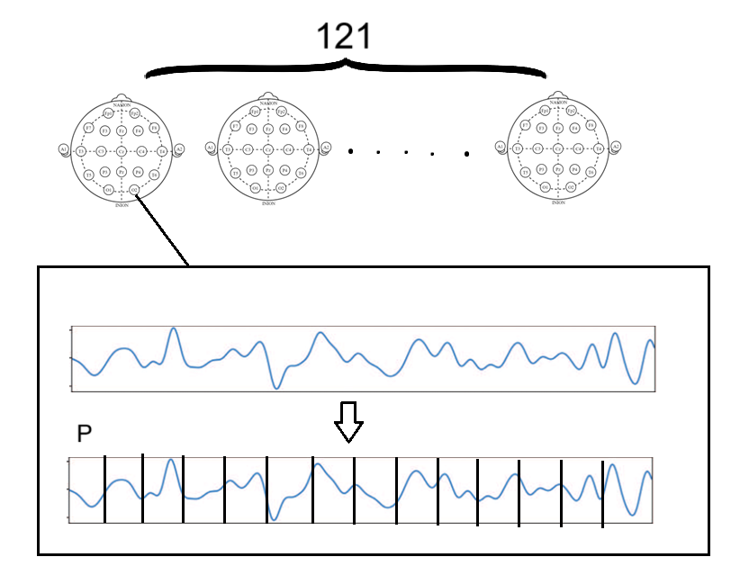
1)

Slide 14
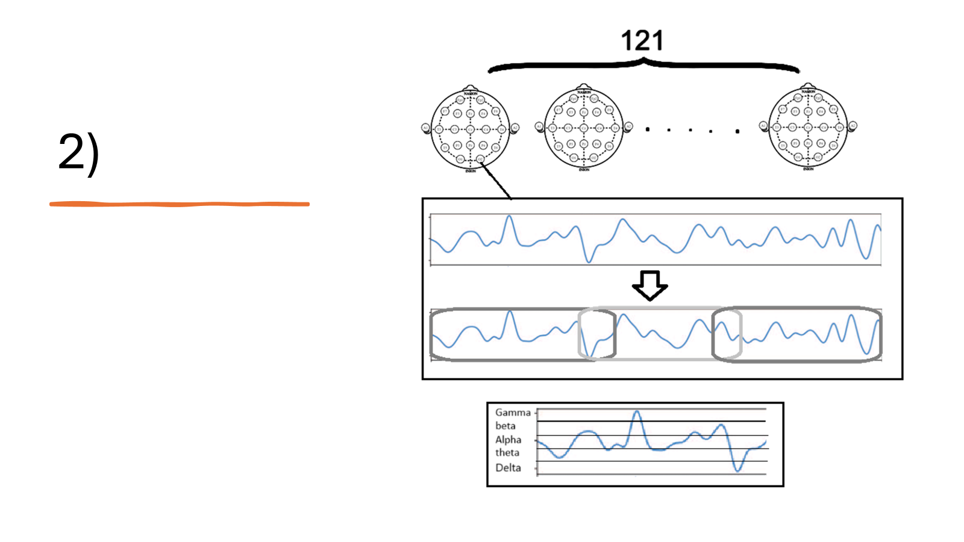
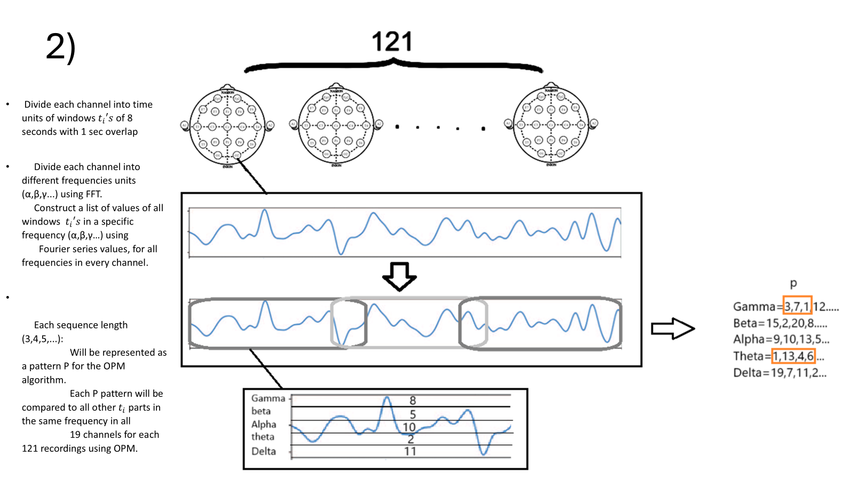

Slide 15
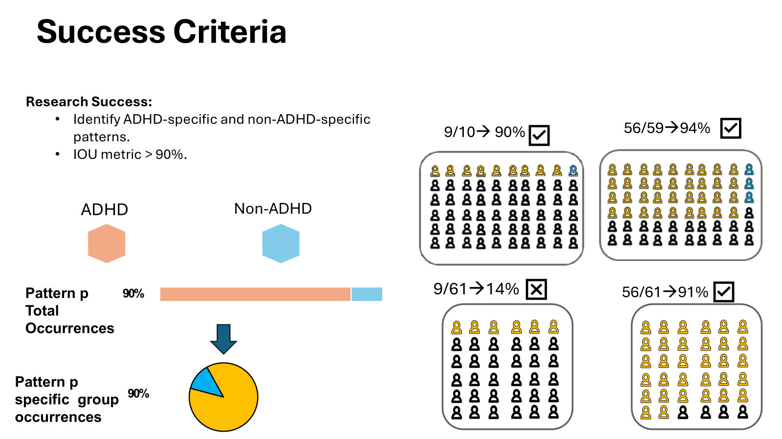


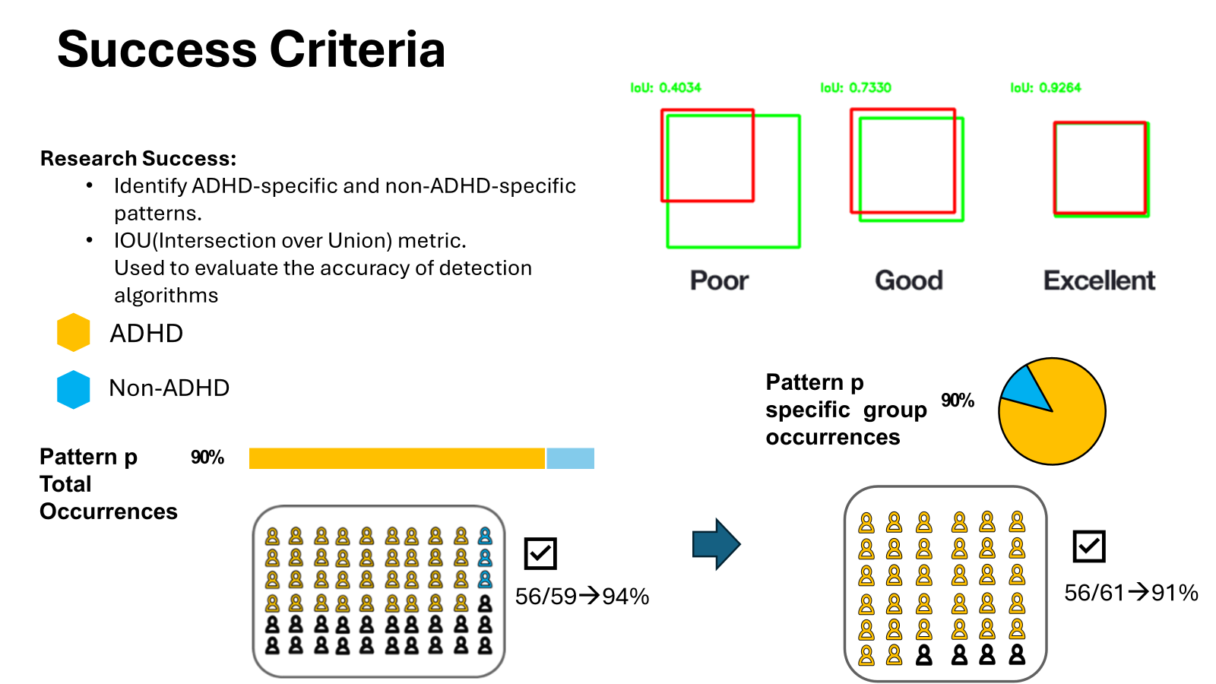
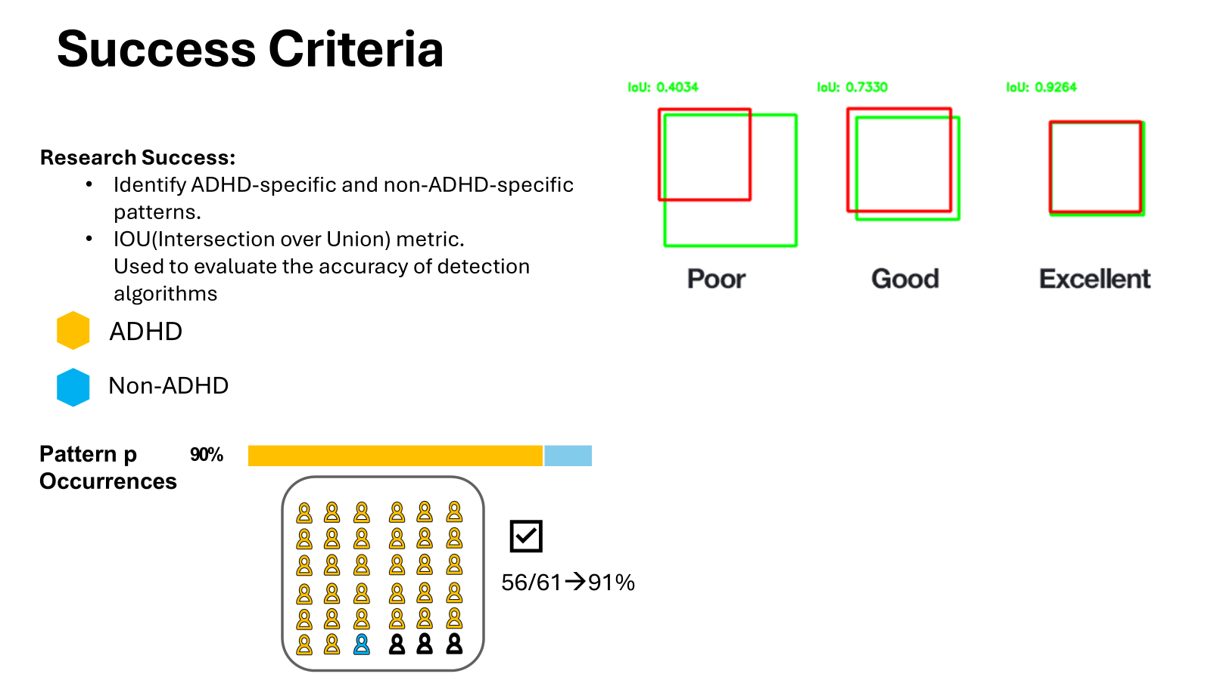
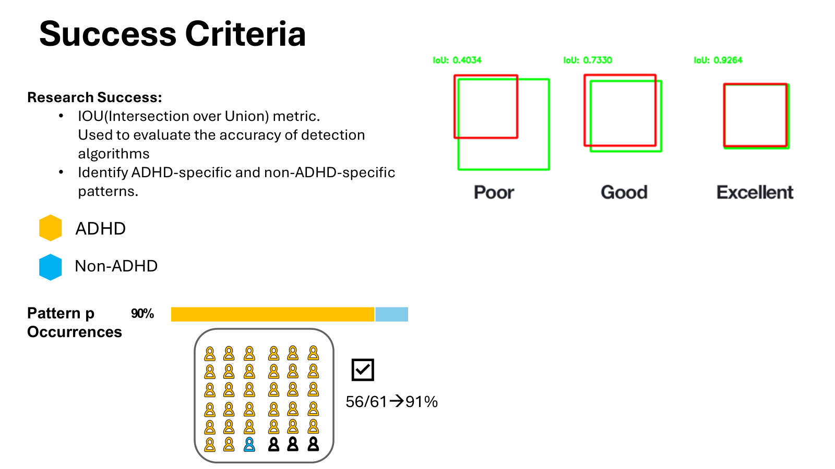


Slide 16


תודה + שאלות

